Slide 1
Inheritance in Java
Instructor :Prashant Mishra
BIAS Bhimtal

Slide 2
Inheritance in Java is a mechanism in which one object acquires all the properties and behaviors of a parent object. It is an important part of OOPs (Object Oriented programming system).
Inheritance represents the IS-A relationship which is also known as a parent-child relationship.
Why use inheritance in java
For Method Overriding (so runtime polymorphism can be achieved).
For Code Reusability.

Slide 3
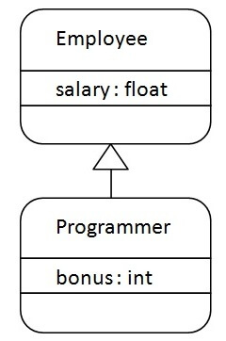
syntax of Java Inheritance
The extends keyword indicates that you are making a new class that derives from an existing class. The meaning of "extends" is to increase the functionality.
In the terminology of Java, a class which is inherited is called a parent or superclass, and the new class is called child or subclass.
Types of inheritance in java
On the basis of class, there can be three types of inheritance in java: single, multilevel and hierarchical.
In java programming, multiple and hybrid inheritance is supported through interface only. We will learn about interfaces later.

Slide 4
class Employee{
float salary=40000;
}
class Programmer extends Employee{
int bonus=10000;
public static void main(String args[]){
Programmer p=new Programmer();
System.out.println("Programmer salary is:"+p.salary);
System.out.println("Bonus of Programmer is:"+p.bonus);
}
}
Programmer salary is:40000.0 Bonus of programmer is:10000

Slide 5
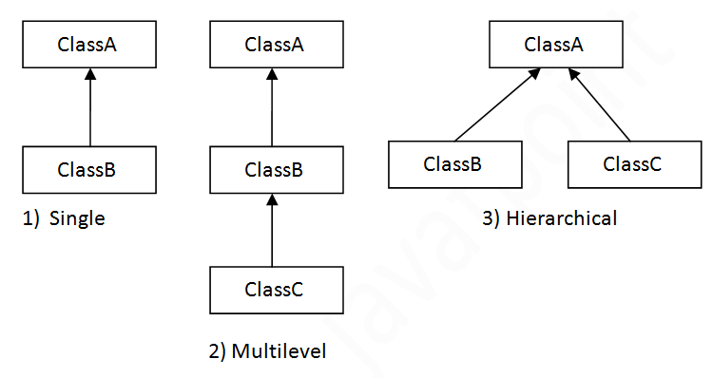
Types of inheritance in java

Slide 6
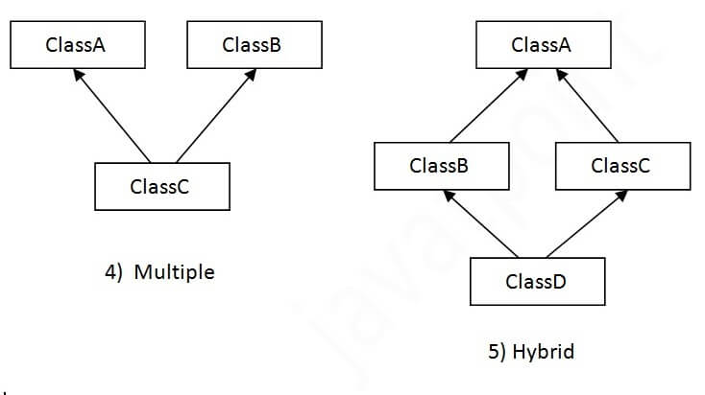
Note: Multiple inheritance is not supported in Java through class.

Slide 7
Single Inheritance Example TestInheritance.java
class Animal{
void eat(){System.out.println("eating...");}
}
class Dog extends Animal{
void bark(){System.out.println("barking...");}
}
class TestInheritance{
public static void main(String args[]){
Dog d=new Dog();
d.bark();
d.eat();
}}
Output:
barking...
eating...

Slide 8
Multilevel Inheritance Example TestInheritance2.java
class Animal{
void eat(){System.out.println("eating...");}
}
class Dog extends Animal{
void bark(){System.out.println("barking...");}
}
class BabyDog extends Dog{
void weep(){System.out.println("weeping...");}
}
class TestInheritance2{
public static void main(String args[]){
BabyDog d=new BabyDog();
d.weep();
d.bark();
d.eat();
}}
Output:
weeping...
barking...
eating...

Slide 9
Hierarchical Inheritance Example TestInheritance3.java
class Animal{
void eat(){System.out.println("eating...");}
}
class Dog extends Animal{
void bark(){System.out.println("barking...");}
}
class Cat extends Animal{
void meow(){System.out.println("meowing...");}
}
class TestInheritance3{
public static void main(String args[]){
Cat c=new Cat();
c.meow();
c.eat();
//c.bark();//C.T.Error
}}
Output:
meowing...
eating...

Slide 10
Aggregation in Java
If a class have an entity reference, it is known as Aggregation. Aggregation represents HAS-A relationship.
Consider a situation, Employee object contains many information such as id, name, emailId etc. It contains one more object named address, which contains its own information such as city, state, country, zipcode etc. as given below.
class Employee{
int id;
String name;
Address address;//Address is a class
...
}
In such case, Employee has an entity reference address, so relationship is Employee HAS-A address.

Slide 11
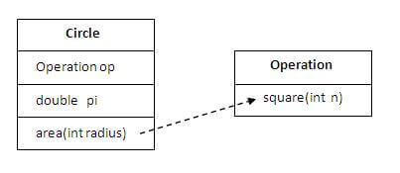
Simple Example of Aggregation
class Operation{
int square(int n){
return n*n;
}
}
class Circle{
Operation op;//aggregation
double pi=3.14;
double area(int radius){
op=new Operation();
int rsquare=op.square(radius);
//code reusability (i.e. delegates the method call).
return pi*rsquare;
}
public static void main(String args[]){
Circle c=new Circle();
double result=c.area(5);
System.out.println(result);
}
}
When use Aggregation?
Code reuse is also best achieved by aggregation when there is no is-a relationship.
Inheritance should be used only if the relationship is-a is maintained throughout the lifetime of the objects involved; otherwise, aggregation is the best choice.

Slide 12
example of Aggregation
In this example, Employee has an object of Address, address object contains its own information such as city, state, country etc. In such case relationship is Employee HAS-A address.
public class Emp {
int id;
String name;
Address address;
public Emp(int id, String name,Address address) {
this.id = id;
this.name = name;
this.address=address;
}
void display(){
System.out.println(id+" "+name);
System.out.println(address.city+" "+address.state+" "+address.country);
}
public static void main(String[] args) {
Address address1=new Address("gzb","UP","india");
Address address2=new Address("gno","UP","india");
Emp e=new Emp(111,"varun",address1);
Emp e2=new Emp(112,"arun",address2);
e.display();
e2.display();
}
}
Output:
varun
gzb UP india
112 arun gno UP india

